Slide 1
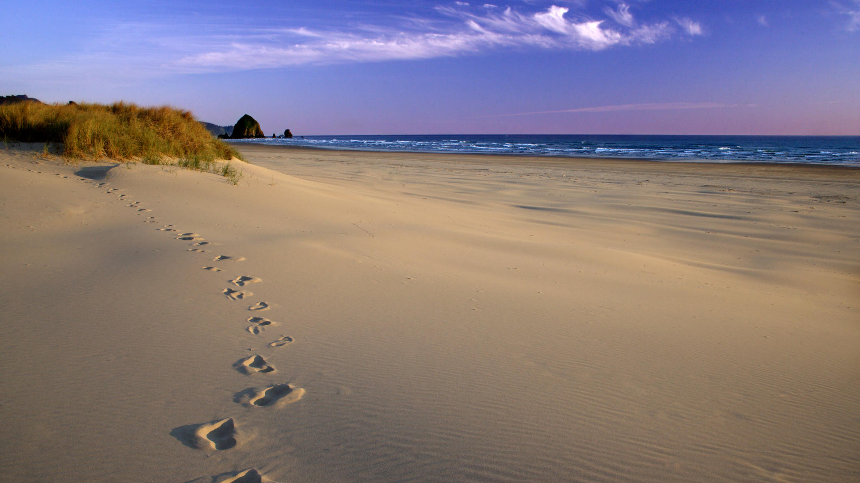
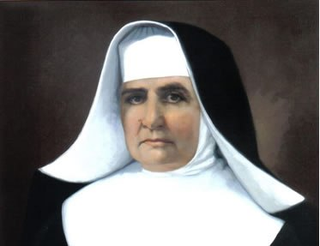
The thoughts of
Mo. Assunta Marchetti

Slide 2
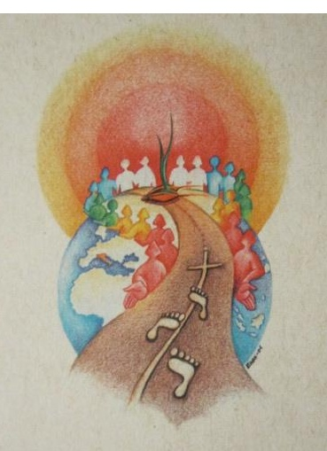
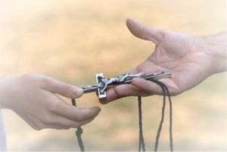
“Let us work for
the real good
of our Congregation”

Slide 3
“I’m happy
wherever
obedience
wants me”

Slide 4
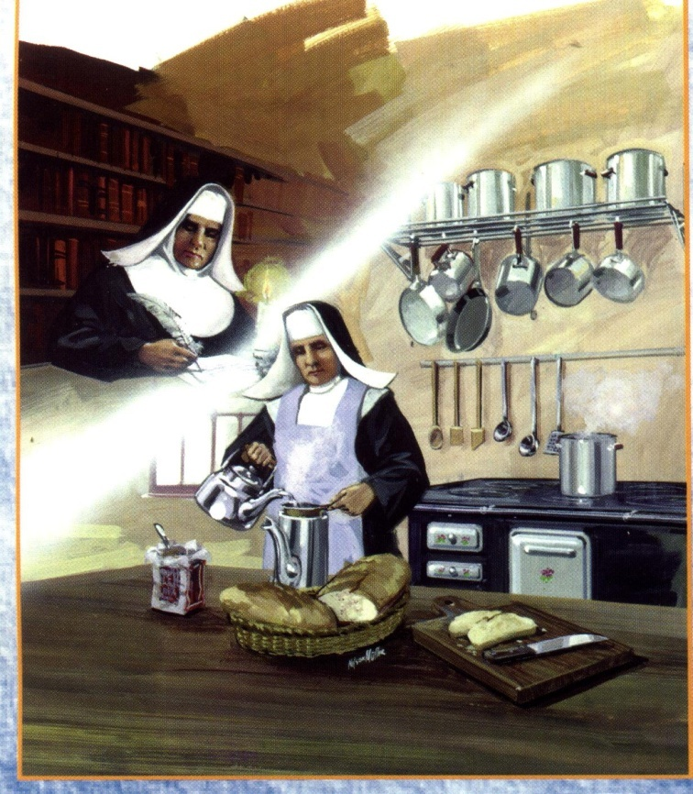
“For Him and
in Him, here I am
in this most delicate
and thorny function”

Slide 5
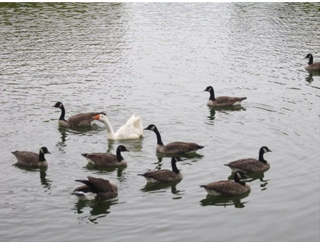
“All is well, even that which
I don’t understand”

Slide 6
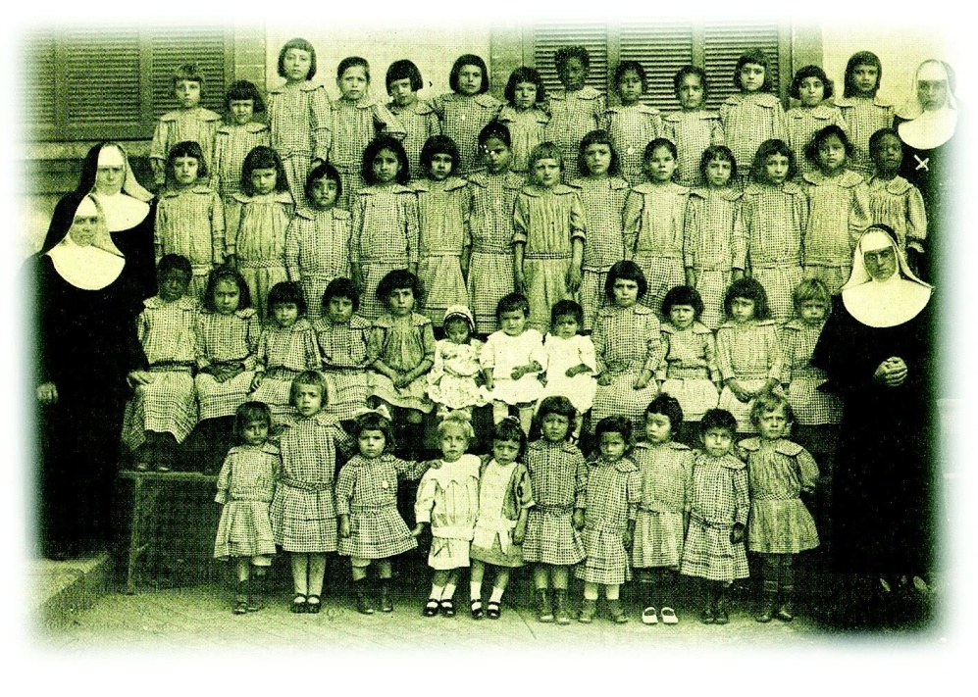
“Don’t thank me, but thank Jesus
for having given me the Grace to help you”

Slide 7
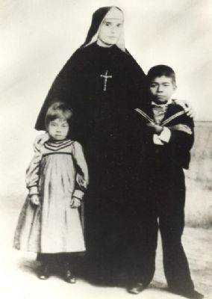
“...the Good God
has given us
a visible sign of
admirable
protection”

Slide 8
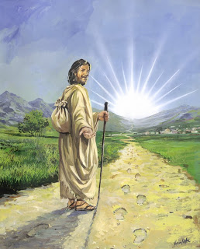
“...we must respond
to such a great
Favor with
enthusiasm
and abnegation”

Slide 9
“I thank
Jesus
who wants to
try me in
all things”

Slide 10
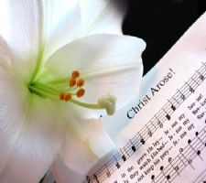
“...I congratulate myself
for your firmness
and holy spirit
of sacrifice”

Slide 11
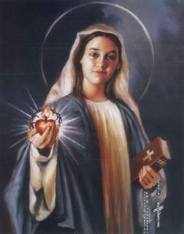
“I put
all my trust
in his
most
sweet Heart”

Slide 12
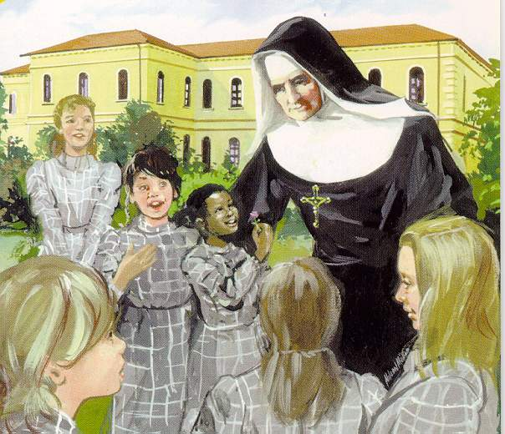
“Let us place
ourselves
in the hand
of God and
do His Will”

Slide 13
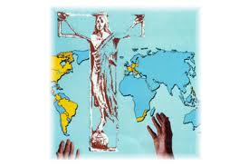
“...a great hope
Smiles on me:
the loyal prompt,
and generous
cooperation
of all the sisters”

Slide 14
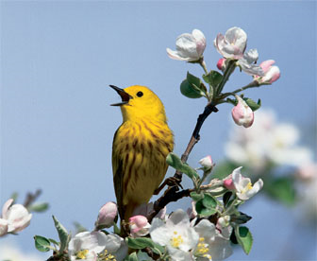
“God sees,
God provides”

Slide 15
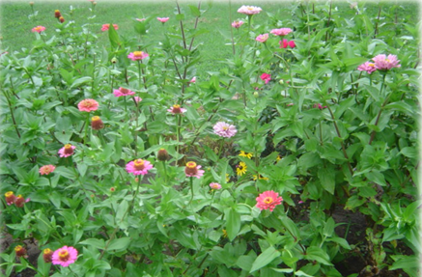
“...I count much
on your prudence,
goodness and
charity...”

Slide 16
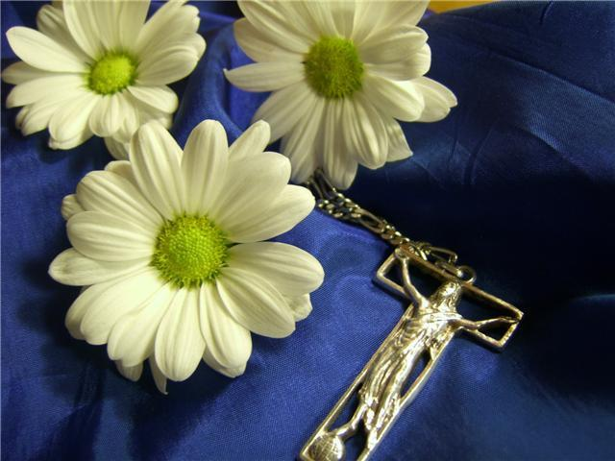
“The Lord will
take care of us!”

Slide 17
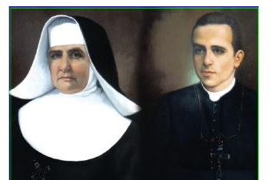
“We did and
endured everything
in order to do
the Will of God”

Slide 18
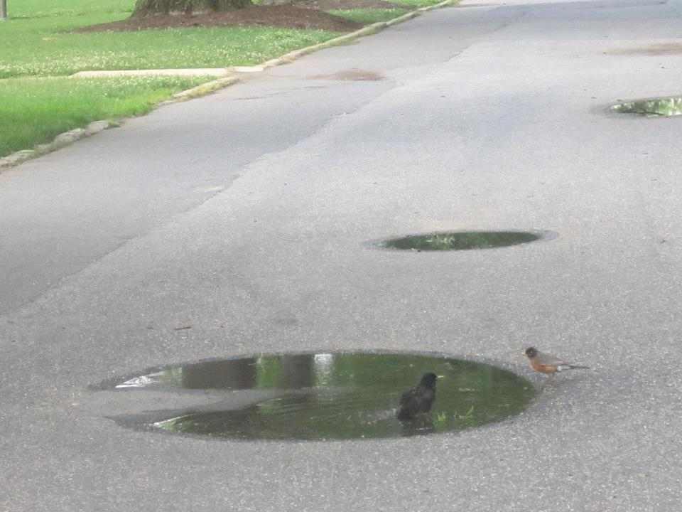
“For His works
God uses the most
inapt and
insignificant
instruments”

Slide 19
“Now our concern
is about uniting ourselves...
to resume the journey,
or better to begin
a new life”

